Slide 1
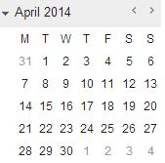

PART
November 2014 Update
Program Launch
First 8 Months of Enrollment:
157 individuals enrolled
150 individuals referred to a safe facility
68 individuals in recovery coaching
45 individuals receiving case management
30 individuals currently in treatment

Slide 2
PART Client Profile
Notes:
Surprised us that PART had almost 100% homeless enroll
I copied the sobering center chart as a picture and just regular, copy-paste to see which one you prefer. –Ashley

Slide 3
PART Client Profile
Notes:
Self report indicators
Normal to see mental health combined with substance use disorders
Licensed professional now added to our staff
Add Psych Technicians to sobering unit due to mental health issues

Slide 4
PART Client Profile

